Slide 1
Software Engineering
Java Unit Testing with Junit
CS 1530
Summer 2020
Instructor: Sohel Sarwar
University of Pittsburgh
Lecture 13

Slide 2
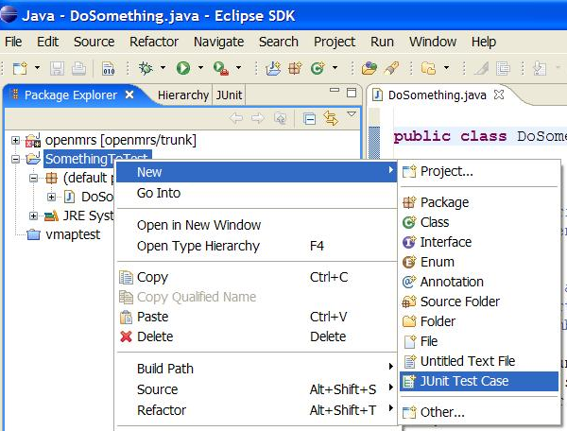
JUnit and Eclipse
To add JUnit to an Eclipse project, click:
Project → Properties → Build Path → Libraries → Add Library... → JUnit → JUnit 5 → Finish
To create a test case:
right-click a file and choose New → Test Case
or click File → New → JUnit Test Case
Eclipse can create stubs of method tests for you.

Slide 3
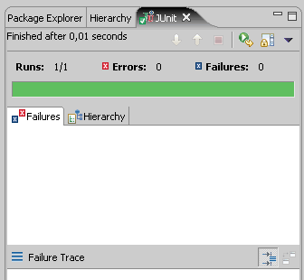
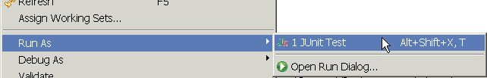
Running a test
Right click it in the Eclipse Package Explorer at left; choose:
Run As → JUnit Test
The JUnit bar will show green if all tests pass, red if any fail.
The Failure Trace shows which tests failed, if any, and why.

Slide 4
Writing a TestCase
To start using JUnit, create a subclass of TestCase, to which you add test methods
Here’s a skeletal test class:
import junit.framework.TestCase;
public class TestBowl extends TestCase {
} //Test my class Bowl
Name of class is important – should be of the form TestMyClass or MyClassTest
This naming convention lets TestRunner automatically find your test classes

Slide 5
Writing methods in TestCase
Pattern follows programming by contract paradigm:
Set up preconditions
Exercise functionality being tested
Check postconditions
Example:
public void testEmptyList() {
Bowl emptyBowl = new Bowl();
assertEquals(“Size of an empty list should be zero.”,
0, emptyList.size());
assertTrue(“An empty bowl should report empty.”, emptyBowl.isEmpty());
}
Things to notice:
Specific method signature – public void testWhatever()
Allows them to be found and collected automatically by JUnit
Coding follows pattern
Notice the assert-type calls…

Slide 6
More stuff in test classes
Suppose you want to test a class Counter
public class CounterTest extends junit.framework.TestCase {
This is the unit test for the Counter class
public CounterTest() { } //Default constructor
protected void setUp()
Test fixture creates and initializes instance variables, etc.
protected void tearDown()
Releases any system resources used by the test fixture
public void testIncrement(), public void testDecrement()
These methods contain tests for the Counter methods increment(), decrement(), etc.
Note capitalization convention
Junit Framework Methods (setup() and teardown()

Slide 7
A JUnit test class
import org.junit.*;
import static org.junit.Assert.*;
public class NameTest {
...
@Test
public void testName() { // a test case method
...
}
}
A method with @Test is flagged as a JUnit test case.
All @Test methods run when JUnit runs your test class.

Slide 8
JUnit Test Fixtures
A test fixture is a fixed state of a set of objects used as a baseline for running tests. The purpose of a test fixture is to ensure that there is a well known and fixed environment in which tests are run so that results are repeatable. Examples of fixtures:
Preparation of input data and setup/creation of fake or mock objects
Loading a database with a specific, known set of data
Copying a specific known set of files creating a test fixture will create a set of objects initialized to certain states.

Slide 9
JUnit Test Fixtures
JUnit provides annotations so that test classes can have fixture run before or after every test, or one time fixtures that run before and after only once for all test methods in a class.
There are four fixture annotations:
2 class-level fixtures: @BeforeClass and @AfterClass
2 method-level ones: @Before and @After

Slide 10
JUnit Annotations
List of important and frequently used annotations:
@Before
@BeforeClass
@After
@AfterClass
@Test
@Ignore
@Test(timeout=500)
@Test(expected=IllegalArgumentException.class)

Slide 11
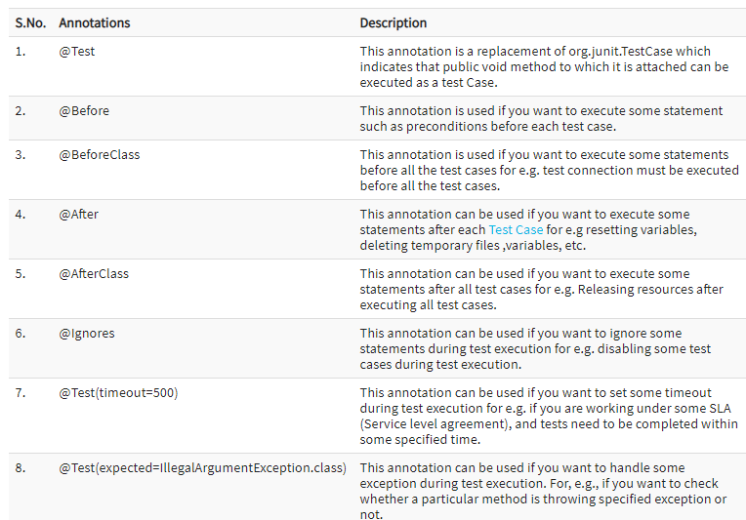
JUnit Annotations

Slide 12
JUnit assertion methods
Each assert method has parameters like these: expected-value, actual-value, message
Assert methods dealing with floating point numbers get an additional argument, a tolerance
Each assert method has an equivalent version that does not take a message – however, this use is not recommended because:
messages helps documents the tests
messages provide additional information when reading failure logs

Slide 13
JUnit assertion methods
Each method can also be passed a string to display if it fails:
e.g. assertEquals("message", expected, actual) or assertEquals (expected, actual, "message")depending on the version of the Junit Framework.
Why is there no pass method?
assertTrue(test) | fails if the boolean test is false
assertFalse(test) | fails if the boolean test is true
assertEquals(expected, actual) | fails if the values are not equal
assertSame(expected, actual) | fails if the values are not the same (by ==)
assertNotSame(expected, actual) | fails if the values are the same (by ==)
assertNull(value) | fails if the given value is not null
assertNotNull(value) | fails if the given value is null
fail() | causes current test to immediately fail

Slide 14
JUnit Sample Test Code Skeleton
@Test
public void testAnotherThing() {
// Code that tests another thing
}
@Test
public void testSomethingElse() {
// Code that tests something else
}
@After
public void tearDown() throws Exception {
// Code executed after each test
}
@AfterClass
public static void tearDownClass() throws Exception {
// Code executed after the last test method
}
}
public class MyTest {
@BeforeClass
public static void setUpClass() throws Exception {
// Code executed before the first test method
}
@Before
public void setUp() throws Exception {
// Code executed before each test
}
@Test
public void testOneThing() {
// Code that tests one thing
}

Slide 15
JUnit tests for Counter
public class CounterTest extends junit.framework.TestCase { Counter counter1; public CounterTest() { } // default constructor
@Before protected void setUp() { // creates a (simple) test fixture counter1 = new Counter(); }
@Test public void testIncrement() { assertTrue(counter1.increment() == 1); assertTrue(counter1.increment() == 2); }
@Test public void testDecrement() { assertTrue(counter1.decrement() == -1); } }

Slide 16
ArrayIntList JUnit test
import org.junit.*;
import static org.junit.Assert.*;
public class TestArrayIntList {
@Test
public void testAddGet1() {
ArrayIntList list = new ArrayIntList();
list.add(42);
list.add(-3);
list.add(15);
assertEquals(42, list.get(0));
assertEquals(-3, list.get(1));
assertEquals(15, list.get(2));
}
@Test
public void testIsEmpty() {
ArrayIntList list = new ArrayIntList();
assertTrue(list.isEmpty());
list.add(123);
assertFalse(list.isEmpty());
list.remove(0);
assertTrue(list.isEmpty());
}
...
How can you improve this test class?
Maybe by adding
@Before to manage
the test fixtures better

Slide 17
JUnit exercise
Given a Date class with the following methods:
public Date(int year, int month, int day)
public Date() // today
public int getDay(), getMonth(), getYear()
public void addDays(int days) // advances by days
public int daysInMonth()
public String dayOfWeek() // e.g. "Sunday"
public boolean equals(Object o)
public boolean isLeapYear()
public void nextDay() // advances by 1 day
public String toString()
Come up with unit tests to check the following:
That no Date object can ever get into an invalid state.
That the addDays method works properly.
It should be efficient enough to add 1,000,000 days in a call.
Notes:
a good equals method has some initial checks like checking for null, checking whether this == that, check instanceof, etc... then it calls compareTo

Slide 18
What's wrong with this?
public class DateTest {
@Test
public void test1() {
Date d = new Date(2050, 2, 15);
d.addDays(4);
assertEquals(d.getYear(), 2050);
assertEquals(d.getMonth(), 2);
assertEquals(d.getDay(), 19);
}
@Test
public void test2() {
Date d = new Date(2050, 2, 15);
d.addDays(14);
assertEquals(d.getYear(), 2050);
assertEquals(d.getMonth(), 3);
assertEquals(d.getDay(), 1);
}
}

Slide 19
Well-structured assertions
public class DateTest {
@Test
public void test1() {
Date d = new Date(2050, 2, 15);
d.addDays(4);
assertEquals(2050, d.getYear()); // expected
assertEquals(2, d.getMonth()); // value should
assertEquals(19, d.getDay()); // be at LEFT
}
@Test
public void test2() {
Date d = new Date(2050, 2, 15);
d.addDays(14);
assertEquals(2050, d.getYear(), "year after +14 days");
assertEquals(3, d.getMonth(), "month after +14 days");
assertEquals(1, d.getDay(), "day after +14 days");
} // test cases should usually have messages explaining
} // what is being checked, for better failure output

Slide 20
Expected answer objects
public class DateTest {
@Test
public void test1() {
Date d = new Date(2050, 2, 15);
d.addDays(4);
Date expected = new Date(2050, 2, 19);
assertEquals(expected, d); // use an expected answer
} // object to minimize tests
@Test
public void test2() {
Date d = new Date(2050, 2, 15);
d.addDays(14);
Date expected = new Date(2050, 3, 1);
assertEquals(expected, d, "date after +14 days");
}
}

Slide 21
Naming test cases
public class DateTest {
@Test
public void test_addDays_withinSameMonth_1() {
Date actual = new Date(2050, 2, 15);
actual.addDays(4);
Date expected = new Date(2050, 2, 19);
assertEquals(expected, actual, "date after +4 days");
}
// give test case methods really long descriptive names
@Test
public void test_addDays_wrapToNextMonth_2() {
Date actual = new Date(2050, 2, 15);
actual.addDays(14);
Date expected = new Date(2050, 3, 1);
assertEquals(expected, actual, "date after +14 days");
}
// give descriptive names to expected/actual values
}

Slide 22
What's wrong with this?
public class DateTest {
@Test
public void test_addDays_addJustOneDay_1() {
Date actual = new Date(2050, 2, 15);
actual.addDays(1);
Date expected = new Date(2050, 2, 16);
assertEquals(expected, actual,
"should have gotten " + expected + "\n" +
" but instead got " + actual\n");
}
...
}

Slide 23
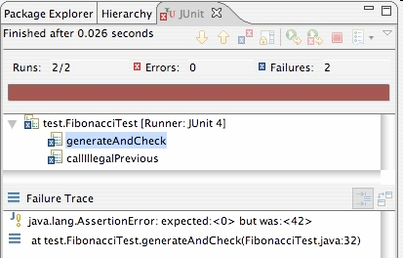
Good assertion messages
public class DateTest {
@Test
public void test_addDays_addJustOneDay_1() {
Date actual = new Date(2050, 2, 15);
actual.addDays(1);
Date expected = new Date(2050, 2, 16);
assertEquals(expected, actual, "adding one day to 2050/2/15");
}
...
}
// JUnit will already show
// the expected and actual
// values in its output;
//
// don't need to repeat them
// in the assertion message

Slide 24
ArrayIntList JUnit test with @Ignore at the method level
import org.junit.*;
import static org.junit.Assert.*;
public class TestArrayIntList {
//Ignore the testAddGet1 method
@Ignore (“Not yet ready please ignore)
@Test
public void testAddGet1() {
ArrayIntList list = new ArrayIntList();
list.add(42);
list.add(-3);
list.add(15);
assertEquals(42, list.get(0));
assertEquals(-3, list.get(1));
assertEquals(15, list.get(2));
}
@Test
public void testIsEmpty() {
ArrayIntList list = new ArrayIntList();
assertTrue(list.isEmpty());
list.add(123);
assertFalse(list.isEmpty());
list.remove(0);
assertTrue(list.isEmpty());
}
...

Slide 25
ArrayIntList JUnit test with @Ignore at the class level
import org.junit.*;
import static org.junit.Assert.*;
//Ignore the entire test class
@Ignore (“Not yet ready please ignore)
public class TestArrayIntList {
@Test
public void testAddGet1() {
ArrayIntList list = new ArrayIntList();
list.add(42);
list.add(-3);
list.add(15);
assertEquals(42, list.get(0));
assertEquals(-3, list.get(1));
assertEquals(15, list.get(2));
}
@Test
public void testIsEmpty() {
ArrayIntList list = new ArrayIntList();
assertTrue(list.isEmpty());
list.add(123);
assertFalse(list.isEmpty());
list.remove(0);
assertTrue(list.isEmpty());
}
...

Slide 26
Tests with a timeout
@Test(timeout = 5000)
public void name() { ... }
The above method will be considered a failure if it doesn't finish running within 5000 ms
private static final int TIMEOUT = 2000;
...
@Test(timeout = TIMEOUT)
public void name() { ... }
Times out / fails after 2000 ms

Slide 27
Pervasive timeouts
public class DateTest {
@Test(timeout = DEFAULT_TIMEOUT)
public void test_addDays_withinSameMonth_1() {
Date d = new Date(2050, 2, 15);
d.addDays(4);
Date expected = new Date(2050, 2, 19);
assertEquals("date after +4 days", expected, d);
}
@Test(timeout = DEFAULT_TIMEOUT)
public void test_addDays_wrapToNextMonth_2() {
Date d = new Date(2050, 2, 15);
d.addDays(14);
Date expected = new Date(2050, 3, 1);
assertEquals("date after +14 days", expected, d);
}
// almost every test should have a timeout so it can't
// lead to an infinite loop; good to set a default, too
private static final int DEFAULT_TIMEOUT = 2000;
}

Slide 28
Testing for exceptions
@Test(expected = ExceptionType.class)
public void name() {
...
}
Will pass if it does throw the given exception.
If the exception is not thrown, the test fails.
Use this to test for expected errors.
@Test(expected = ArrayIndexOutOfBoundsException.class)
public void testBadIndex() {
ArrayIntList list = new ArrayIntList();
list.get(4); // should fail
}

Slide 29
Setup and teardown
@Before
public void name() { ... }
@After
public void name() { ... }
methods to run before/after each test case method is called
@BeforeClass
public static void name() { ... }
@AfterClass
public static void name() { ... }
methods to run once before/after the entire test class runs

Slide 30
Tips for testing
You cannot test every possible input, parameter value, etc.
So you must think of a limited set of tests likely to expose bugs.
Think about boundary cases
positive; zero; negative numbers
right at the edge of an array or collection's size
Think about empty cases and error cases
0, -1, null; an empty list or array
test behavior in combination
maybe add usually works, but fails after you call remove
make multiple calls; maybe size fails the second time only

Slide 31
What's wrong with this?
public class DateTest {
// test every day of the year
@Test(timeout = 10000)
public void tortureTest() {
Date date = new Date(2050, 1, 1);
int month = 1;
int day = 1;
for (int i = 1; i < 365; i++) {
date.addDays(1);
if (day < DAYS_PER_MONTH[month]) {day++;}
else {month++; day=1;}
assertEquals(new Date(2050, month, day), date);
}
}
private static final int[] DAYS_PER_MONTH = {
0, 31, 28, 31, 30, 31, 30, 31, 31, 30, 31, 30, 31
}; // Jan Feb Mar Apr May Jun Jul Aug Sep Oct Nov Dec
}

Slide 32
Trustworthy tests
Test one thing at a time per test method.
10 small tests are much better than 1 test 10x as large.
Each test method should have few (likely 1) assert statements.
If you assert many things, the first that fails stops the test.
You won't know whether a later assertion would have failed.
Tests should avoid logic.
minimize if/else, loops, switch, etc.
avoid try/catch
If it's supposed to throw, use expected= ... if not, let JUnit catch it.
Torture tests are okay, but only in addition to simple tests.

Slide 33
Squashing redundancy
public class DateTest {
@Test(timeout = DEFAULT_TIMEOUT)
public void addDays_withinSameMonth_1() {
addHelper(2050, 2, 15, +4, 2050, 2, 19);
}
@Test(timeout = DEFAULT_TIMEOUT)
public void addDays_wrapToNextMonth_2() {
addHelper(2050, 2, 15, +14, 2050, 3, 1);
}
// use lots of helpers to make actual tests extremely short
private void addHelper(int y1, int m1, int d1, int add,
int y2, int m2, int d2) {
Date act = new Date(y, m, d);
actual.addDays(add);
Date exp = new Date(y2, m2, d2);
assertEquals("after +" + add + " days", exp, act);
}
// can also use "parameterized tests" in some frameworks
...

Slide 34
Flexible helpers
public class DateTest {
@Test(timeout = DEFAULT_TIMEOUT)
public void addDays_multipleCalls_wrapToNextMonth2x() {
Date d = addHelper(2050, 2, 15, +14, 2050, 3, 1);
addhelper(d, +32, 2050, 4, 2);
addhelper(d, +98, 2050, 7, 9);
}
// Helpers can box you in; hard to test many calls/combine.
// Create variations that allow better flexibility
private Date addHelper(int y1, int m1, int d1, int add,
int y2, int m2, int d2) {
Date date = new Date(y, m, d);
addHelper(date, add, y2, m2, d2);
return d;
}
private void addHelper(Date date, int add,
int y2, int m2, int d2) {
date.addDays(add);
Date expect = new Date(y2, m2, d2);
assertEquals("date after +" + add + " days", expect, d);
}
...

Slide 35
Regression testing
regression: When a feature that used to work, no longer works.
Likely to happen when code changes and grows over time.
A new feature/fix can cause a new bug or reintroduce an old bug.
regression testing: Re-executing prior unit tests after a change.
Often done by scripts during automated testing.
Used to ensure that old fixed bugs are still fixed.
Gives your app a minimum level of working functionality.
Many products have a set of mandatory check-in tests that must pass before code can be added to a source code repository.

Slide 36
Test-driven development
Unit tests can be written after, during, or even before coding.
test-driven development: Write tests, then write code to pass them.
Imagine that we'd like to add a method subtractWeeks to our Date class, that shifts this Date backward in time by the given number of weeks.
Write code to test this method before it has been written.
Then once we do implement the method, we'll know if it works.

Slide 37
JUnit summary
Tests need failure atomicity (ability to know exactly what failed).
Each test should have a clear, long, descriptive name.
Assertions should always have clear messages to know what failed.
Write many small tests, not one big test.
Each test should have roughly just 1 assertion at its end.
Always use a timeout parameter to every test.
Test for expected errors / exceptions.
Choose a descriptive assert method, not always assertTrue.
Choose representative test cases from equivalent input classes.
Avoid complex logic in test methods if possible.
Use helpers, @Before to reduce redundancy between tests.

Slide 38

Code Coverage
Code
Coverage
Code coverage is a measure used to describe the degree to which the source code of a program is executed when a particular test suite runs
Code Coverage is classified as a White box testing

Slide 39
Code Coverage Benefits
Code
Coverage
Identify untested part of codebase
Improve the Quality by improved test coverage
Identify the redundant/dead Code
Identify testing gaps or missing tests

Slide 40
Code Coverage Workflow
Code
Coverage
Writing test cases and execute them
Finding areas of code not covered using Code Coverage Tool
Creating additional tests for identified gaps to increase test coverage
Determining a quantitative measure of code coverage

Slide 41
Code Coverage Criteria
Code
Coverage
To measure what percentage of code has been exercised by a test suite, one or more coverage criteria are used
Instructions Coverage
Statements Coverage
Branch Coverage
Method Coverage
Class Coverage

Slide 42
Code Coverage Criteria
Code
Coverage
Report of number of classes from the code base covered
Class Coverage
Method Coverage
Reports whether a method (function) was invoked while testing the application
Branch Coverage
Reports whether Boolean expressions evaluate to true AND false
Statements/Line Coverage
Reports whether each executable statement was executed
Instruction Coverage
Method’s bytecode stream is a sequence of instructions for JVM
The Bytecode for a method are executed when that method is invoked

Slide 43
Code Coverage
Code
Coverage
Method coverage
Branch coverage
Statement coverage
Path coverage

Slide 44
The Emma Code Coverage Tool
Home page:
http://emma.sourceforge.net/
Quick start introduction page:
http://emma.sourceforge.net/intro.html
Download page:
http://sourceforge.net/projects/emma/files/
Emma sample reports page:
http://emma.sourceforge.net/samples.html
Emma FAQ page:
http://emma.sourceforge.net/faq.html

Slide 45
Downloading and Installing Emma
Go to the download page:
http://sourceforge.net/projects/emma/files/
Get the file emma-2.0.5312-lib.zip in the emma-release directory.
The download starts automatically after a short sourceforge advertisement.
Unzip the emma-2.0.5312-lib.zip file and put the file emma.jar in the directory with the code.
You can put the file elsewhere as long as you include the directory in the java class path using the “–cp” option.

